Slide 1
FPGA Implementation of an Improved OMP for
Compressive Sensing Reconstruction
Paper Link

Slide 2
WEEK-1 UPDATE Introduction
Orthogonal Matching Pursuit (OMP) is a widely used greedy algorithm for sparse signal recovery, but its repeated least-squares solves and frequent matrix operations make direct hardware implementations costly in latency and resources. To address this, we modify the OMP update step using Gram-Schmidt orthogonalization so that residual updates avoid repeated full least-squares solutions - effectively requiring the least-squares solution only once per iteration - while preserving the original algorithm’s reconstruction accuracy as confirmed by simulation. This reduces the number of matrix operations and makes the algorithm far more amenable to efficient hardware realization without altering its theoretical recovery properties.

Slide 3
Implementation
We implement the improved OMP in Xilinx Vivado High-Level Synthesis (HLS) as a parameterizable, reconfigurable design that supports multiple signal lengths N, measurement counts M, and sparsity levels K. The HLS implementation achieves substantial runtime gains versus recent HLS-based designs and attains performance for larger problems that is comparable to traditional HDL implementations. The result is a fast, hardware-friendly OMP variant that enables practical, real-time sparse recovery on FPGA platforms while retaining the accuracy of classical OMP.

Slide 4
Use Cases
The improved OMP is well suited to any application that requires fast, on-device sparse recovery from compressed measurements. Typical use cases include compressed sensing imaging (MRI, CT, ultrasound), radar and sonar target detection, wireless channel estimation and MIMO precoding, spectrum sensing for cognitive radio, and continuous biomedical monitoring (ECG/PCG) where low-latency reconstruction is essential.
From an implementation standpoint, the Vivado HLS realization makes the design attractive for rapid prototyping and deployment on FPGA-based platforms. The Gram-Schmidt-accelerated update reduces computation and resource stress, enabling microsecond-level recovery for a range of signal sizes and making the design reconfigurable across different N, M and K. This combination - classical numerical robustness with HLS-driven speed and portability - fits pipelines that need scalable, energy-efficient, and production-ready sparse-recovery blocks (adaptive sensing, live signal analytics, and FPGA-accelerated inference at the network edge).

Slide 5
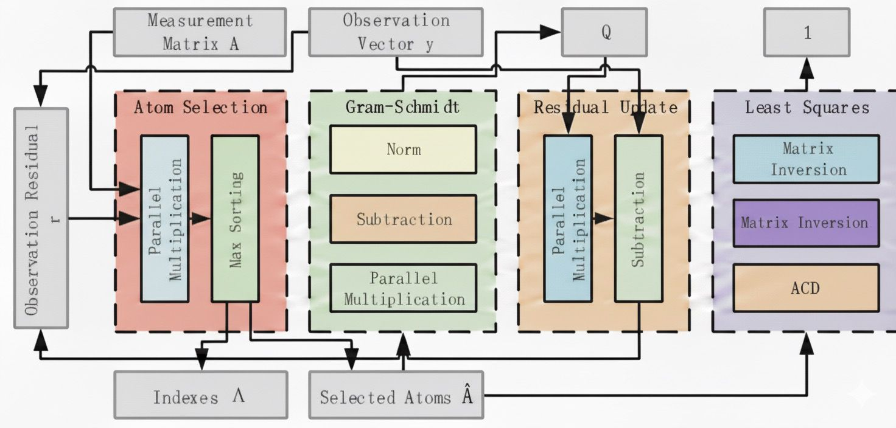
Block diagram
The architecture is divided into 7 main hardware units:
Parallel Multiplication
Multiple multipliers run at the same time.
Vector sum is completed using an adder tree.
Used for inner products and matrix–vector operations.
Max Sorting
After each inner product, compare with current max.
A max register keeps the largest value + index.
Finds the best atom column and stores the index. This way extra memory isn’t used.
Atom Selection Unit
Finds the column (atom) of measurement matrix A that is most correlated with the residual r.
Outputs the index of the best matching atom.

Slide 6
Block Diagram
Gram-Schmidt Unit
Orthogonalizes the selected atoms to produce an orthogonal matrix Q.
Uses parallel multiplication, subtraction and normalization.
Residual Update Unit
Updates the residual using: r_{t} = r_{t-1}- Q_{t} Q_{t}^{T}r_{t-1}
Ensures the new residual is orthogonal to the chosen atoms.
Least-Squares Unit
At the final iteration only, it solves the least-squares problem using Cholesky decomposition.
Produces the final sparse coefficients.
ACD Least-Square
Formula: C⁻¹=(L⁻¹)^{T}D⁻¹L⁻¹
Decomposition of D and L is performed in parallel.
Inversion of L is iterative but pipelined.
Reciprocal of D uses a Goldschmidt-based reciprocal unit, allowing multiple multiplications in parallel.

Slide 7
Work for next week
Develop high-level language implementations of the Orthogonal Matching Pursuit (OMP) and Matching Pursuit (MP) algorithms, and generate a formal Design Requirement Specification (DRS) capturing functional, architectural, and performance constraints.

Slide 8
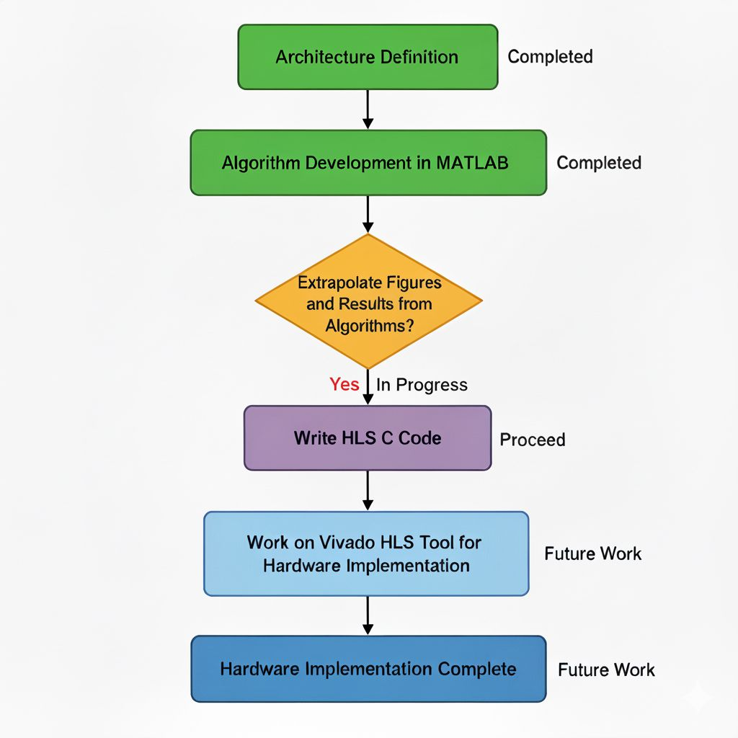
PROGRESS OVERVIEW

Slide 9
WEEK-2 UPDATE
Post Week 1, where the objective was to analyze and understand the reference paper and define the required architecture, the focus shifted to the algorithmic aspect.
Algorithms for both the original OMP (Orthogonal Matching Pursuit) and the IOMP (Improved Orthogonal Matching Pursuit) were designed and implemented in MATLAB.
Efforts were made to extrapolate Figure of Merit (FOM) results from the algorithms.
The two major FOMs emphasized were:
- Reconstruction Accuracy
- Success Rate

Slide 10
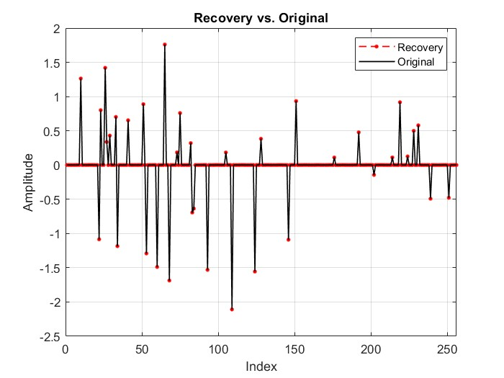
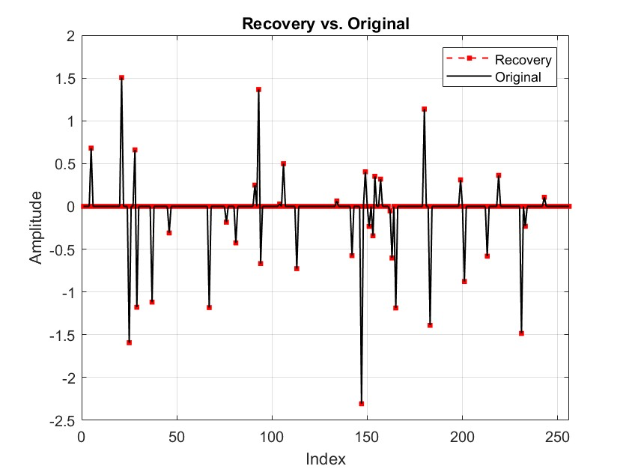
Comparison of Reconstruction Results
(OMP)
(IOMP)
We have tried comparing the reconstruction result of the original OMP algorithm and the proposed Improved OMP algorithm for better understanding.

Slide 11
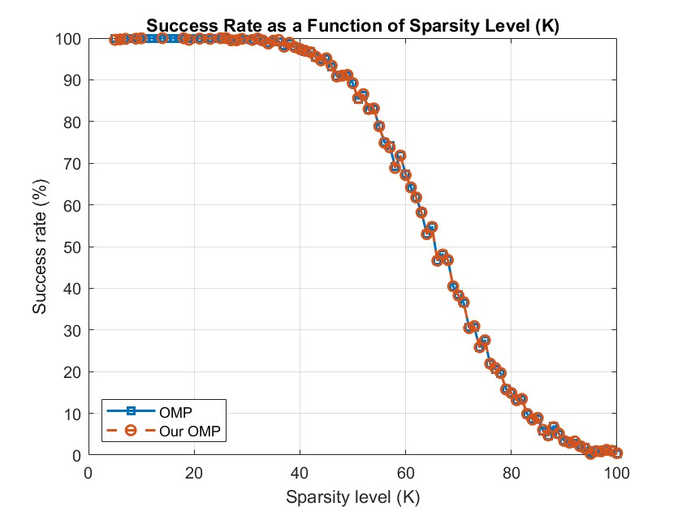
Success Rate Comparison

Slide 12
Work for next week
Focus will be on generating plots and results by parameterizing variables such as K and M.
Image reconstruction and corresponding result generation will be carried out.
C code development will start for High-Level Synthesis (HLS).
Vivado HLS will be used to convert high-level code into synthesizable RTL.

Slide 13
THANK YOU: Team Muxed Up
Sreyas Janamanchi (IMT2022554)
Margasahayam Venkatesh Chirag (IMT2022583)
Shannon Muthanna I B (IMT2022552)
Vedant Mangrulkar(IMT2022519)
Pradyumna G (IMT2022555)
Chinmay Krishna (IMT2022560)

